Slide 1
S. Hariviswa 821721243024 B.Tech., Artificial Intelligence and Data Science – III year Sir Issac Newton College Of Engineering And Technology
3/21/2024 Annual Review

Slide 2
PROJECT TITLE
Image classification
(Using CNN)

Slide 3


AGENDA
The agenda of Image classification using Convolutional Neural
Networks (CNNs) . Image classification, a pivotal task in computer vision, involves categorizing images into predefined classes or labels. It includes several key tasks:
Image preprocessing
Feature Extraction
Selection of training samples
Selection of suitable classification approaches
Post-classification processing
Accuracy Assessment
This task has several broader objectives and potential applications.
3/21/2024 Annual Review

Slide 4

PROBLEM STATEMENT
Image classification remains a challenging task in computer vision due to the complexity and variability of visual data. The problem statement revolves around developing robust algorithms capable of accurately categorizing images into predefined classes or labels.
Addressing these challenges requires innovative approaches in data augmentation, feature representation, model architecture design, training strategies, and optimization techniques.
By addressing these challenges, advancements in image classification can significantly impact various fields including healthcare, agriculture, autonomous vehicles, surveillance, and multimedia content analysis.
3/21/2024 Annual Review

Slide 5

PROJECT OVERVIEW
The project aims to develop an image classification system leveraging state-of-the-art techniques in computer vision to accurately categorize images into predefined classes or labels.
Subsequently, various model architectures are explored, ranging from traditional machine learning classifiers like Support Vector Machines (SVMs) to deep learning architectures like Convolutional Neural Networks (CNNs), with careful consideration given to factors like computational efficiency and scalability.
Overall, the project aims to deliver a robust and efficient image classification system applicable across various domains, with potential applications in healthcare, agriculture, security, and multimedia analysis.
3/21/2024 Annual Review

Slide 6

WHO ARE THE END USERS?
In an image classification project, the end users can vary depending on the specific application domain and the context in which the classification system is deploy.
Researchers and Data Scientists
Developers and Engineers
Business Stakeholders
End Users in Specific Industries
Consumers
Overall, the end users of an image classification project can vary widely depending on the application domain, and it's essential to consider their needs, preferences, and expertise during system design, development, and deployment.
3/21/2024 Annual Review

Slide 7

YOUR SOLUTION AND ITS VALUE PROPOSITION
Our solution offers a comprehensive and efficient approach to image classification, addressing key challenges in computer vision with innovative techniques and methodologies.
Our solution's value proposition lies in its ability to deliver reliable and interpretable results, empowering users to make informed decisions in various domains such as healthcare, agriculture, security, and multimedia analysis
Overall, our solution represents a cutting-edge approach to image classification, offering tangible benefits in terms of accuracy, reliability, and applicability across a wide range of industries and applications.
3/21/2024 Annual Review

Slide 8

THE WOW IN YOUR SOLUTION
Our image classification solution introduces a groundbreaking approach that revolutionizes the way we interpret and categorize visual data.
What truly sets our solution apart is its seamless integration of advanced algorithms with user-friendly interfaces, empowering users to effortlessly navigate and leverage the power of image classification for their specific needs.
With each classification, our solution delivers not just results, but a transformative experience that inspires awe and unlocks new possibilities in the realm of computer vision.
3/21/2024 Annual Review
8

Slide 9
MODELLING
Our solution offers a comprehensive and efficient approach to image classification, addressing key challenges in computer vision with innovative techniques and methodologies
Through careful data preprocessing, model selection, and training optimization, we ensure the system's effectiveness in handling variations in illumination, scale, orientation, and occlusion within images.
Overall, our solution represents a cutting-edge approach to image classification, offering tangible benefits in terms of accuracy, reliability, and applicability across a wide range of industries and applications.
3/21/2024 Annual Review
9

Slide 10
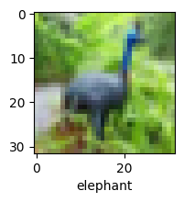
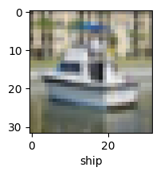
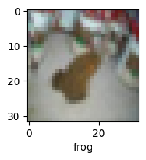
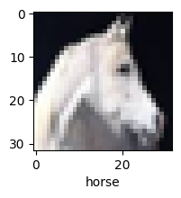
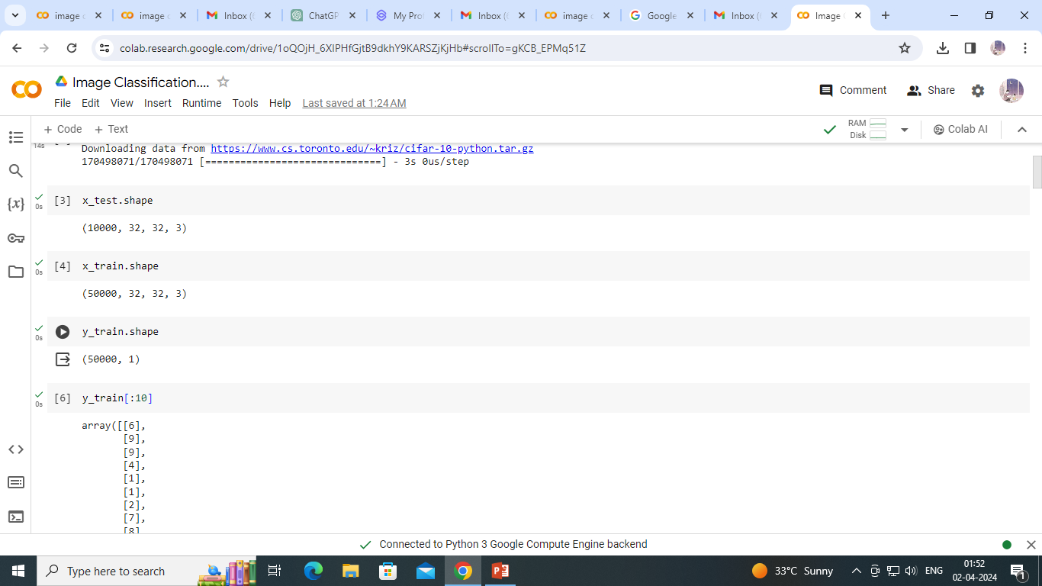
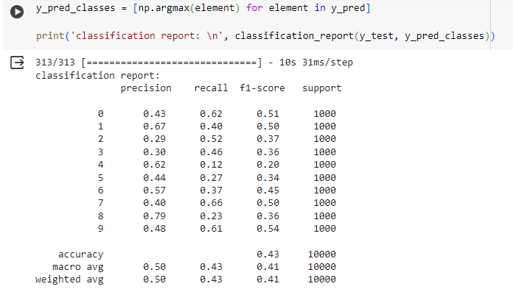
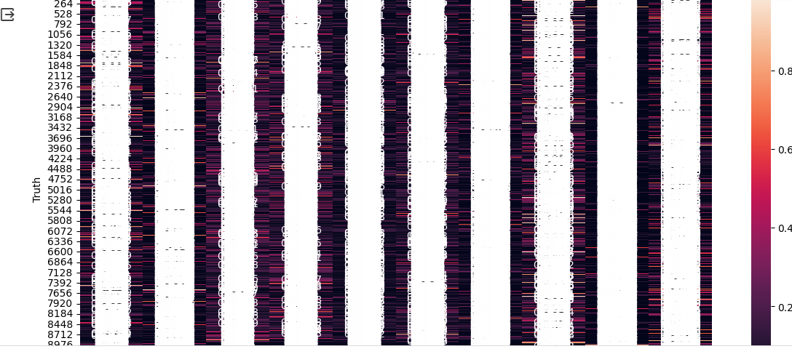
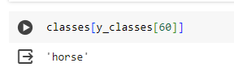
RESULTS
Demo Link
3/21/2024 Annual Review
10

